Slide 1

A case study for trasaction amount prediction
Jesus Blanquer

Slide 2
Assumptions
1
The values provided in the dataset accurately reflect users' financial transactions and are free from errors or inconsistencies.
2
Some features or columns in the dataset may not contribute significantly to predicting transaction amounts and can be safely removed during model training.
3
There is no strong linear relationship between the features in the dataset, indicating that they are relatively independent of each other.
4
The nature of financial transactions does not lend itself to traditional forecasting methods due to the absence of repeating or sequential patterns over time

Slide 3
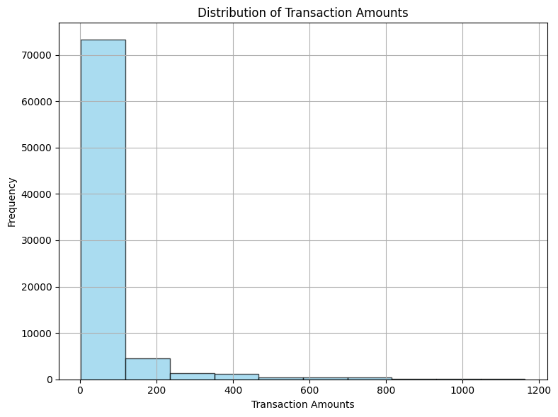
Dataset Analysis: Distribution of Transaction Amounts
The dataset's transaction amounts exhibit a skewed distribution, with transactions between 0 to 200 units being most prevalent. This skewness can:
Challenge prediction accuracy for less frequent or extreme transaction values.
Potentially bias model performance towards optimizing predictions for common transaction amounts.

Slide 4
Handling Imbalanced Data
Addressing the imbalance in sample sizes across transaction amount ranges is crucial for developing robust predictive models. Two common approaches are oversampling and undersampling.
Oversampling:
Involves increasing the number of instances in the minority class to balance the class distribution.
Challenge: The dataset's skewed distribution and limited number of samples make traditional oversampling techniques like SMOTE impractical, as generating synthetic samples may not effectively address the imbalance.
Undersampling:
Involves reducing the number of instances in the majority class to balance the class distribution.
Challenge: Undersampling may result in the loss of crucial information and patterns present in the majority class, potentially leading to biased or less accurate predictions.

Slide 5
Model Development Process Overview
Data Preprocessing
Removed irrelevant features and handled missing values.
Engineered new features and encoded categorical variables.
Implemented random undersampling for class imbalance.
Model Training
Conducted cross-validation during training to ensure model robustness.
Tuned hyperparameters using cross-validated Bayesian optimization.
Evaluation
Assessed model performance using metrics like MSE, RMSE, MAE, and R2.

Slide 6
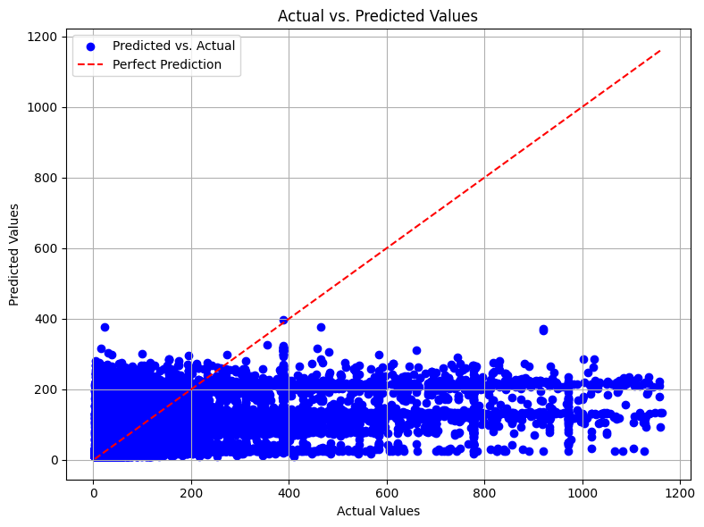
Model Evaluation Results
Evaluation Metrics
Mean Squared Error (MSE): 10224.20
Root Mean Squared Error (RMSE): 101.11
Mean Absolute Error (MAE): 48.19
Explained Variance Score: 0.20
Median Absolute Error (MedAE): 19.95
R-squared (R2) Score: 0.20
Conclusion
The model explains 20% of the variance in transaction amounts, suggesting that there are other factors not captured by the current model.
The model shows moderate performance in predicting transaction amounts, as indicated by metrics such as RMSE, MAE, and R-squared score.

Slide 7
Next Steps for Model Enhancement
Explore More Features: adding new features such as transaction frequency, average transaction amount, or average transaction amount per category.
Feature Selection: Refine feature selection methods to identify the most relevant features for the regression task.
Experiment with Models: try different regression algorithms like linear regression, support vector regression, or gradient boosting regression. Compare their performance metrics to identify the most suitable model for your dataset
Use Ensemble Techniques: consider exploring other ensemble techniques like gradient boosting regression or stacking regression.

Slide 8
Analysis Questions
Confidence in Results:
While the model's predictions may not be entirely precise, this could be attributed to the limitations of the available data or the inherent challenge of predicting with the provided information. Nevertheless, I acknowledge that there is still room for improvement and refinement.
Evaluation Metrics:
I am employing various metrics to assess the performance of our model. These metrics offer valuable insights into areas for enhancement and guide our ongoing efforts to enhance the accuracy and effectiveness of the model.

